Slide 1
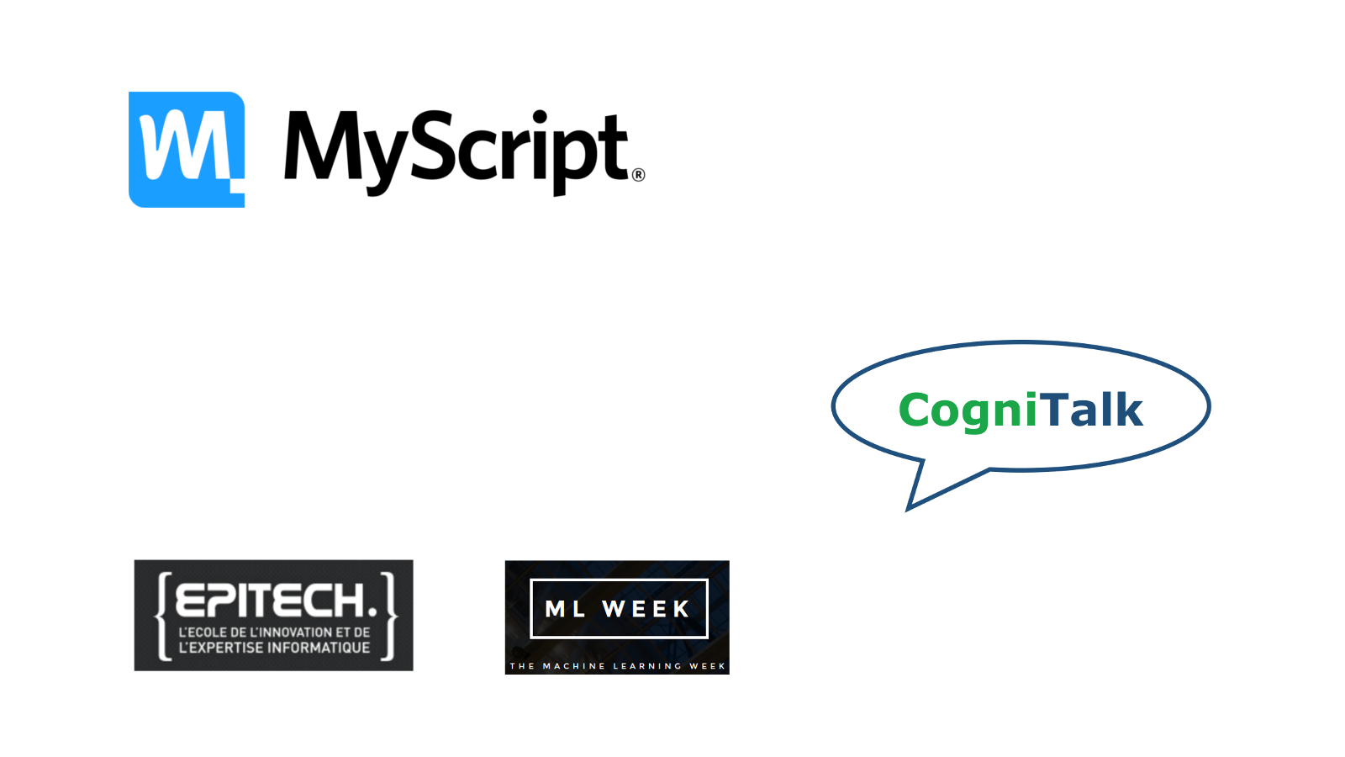


Nantes ML Meetup:
Overview of Generative Adversarial Networks (GANs)
jakublangr.com
@langrjakub

Slide 2
Today’s lecture
Briefly touch on (Un)supervised ML
Talk about ML from distributional perspective
Recap of GANs (NS-GAN, MM-GAN)
Manifold assumption
Popular architectures: WGAN, PGGAN (plus training dynamics), CycleGAN
Adversarial Examples
Practical Examples
Colabs / Anything you’d like to know
Q&A
Videos of work

Slide 3
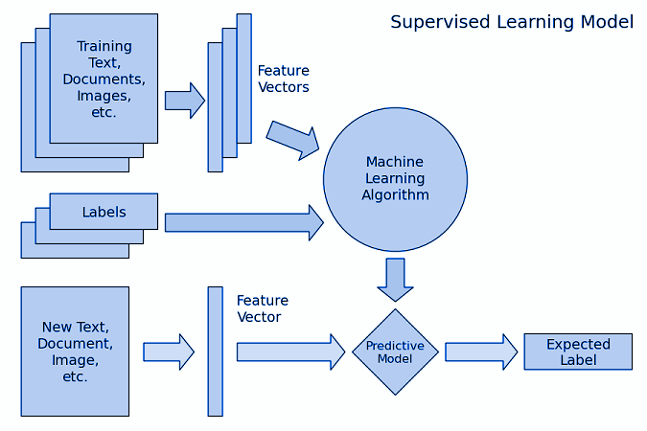
Supervised Machine Learning
Notes:
Has an explicit loss function

Slide 4
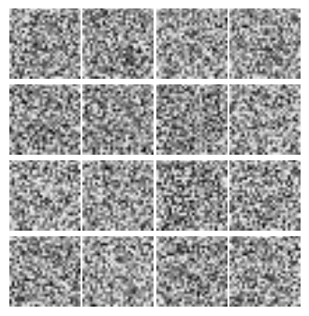
What is generative modeling?
(Unsupervised ML)
“ What I cannot create, I do not understand.”
— Richard Feynman
Unsupervised ML and especially generative modelling has been underappreciated until quite recently
We are trying to generate examples that look like they came from the original distribution using some learnable function generate()
Notes:
So most people have not done much gen. model so this is for baselining. There are many ways but in ML we try to have a gen() function and improve it.
We’re always trying to max some real data distr., but different objective functions: so we’re really introducing two agents competing.
Complicated to the point of being intractable even just for evaluation

Slide 5
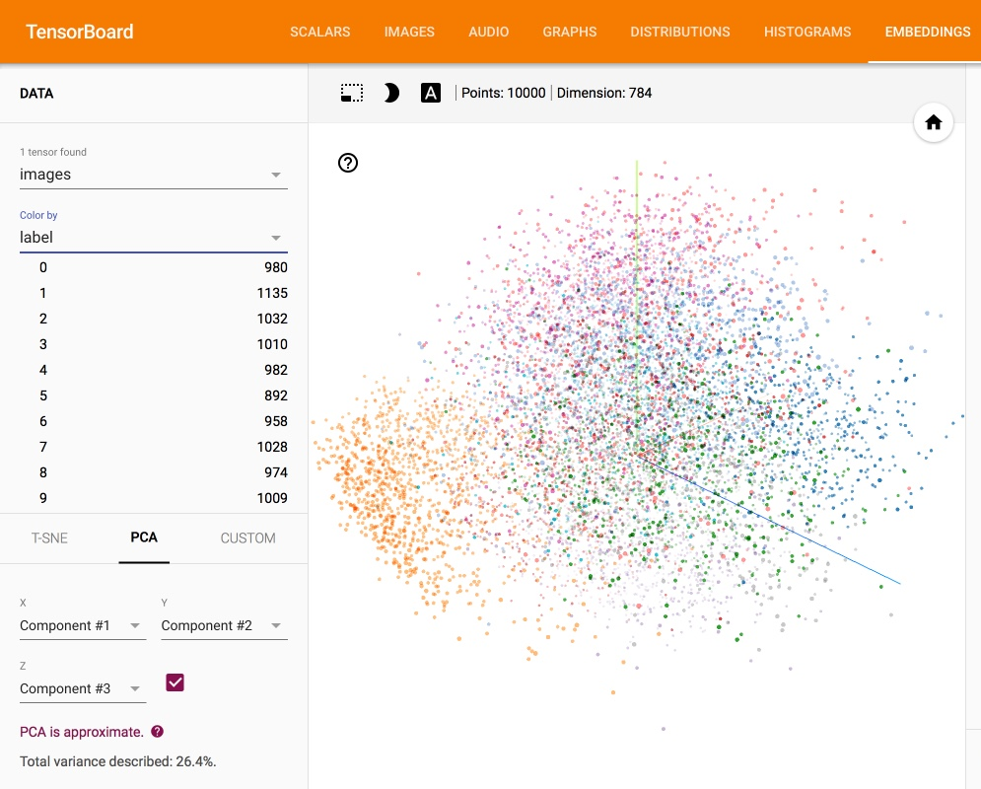
What is generative modeling?
(Unsupervised ML)
Most approaches use some form of Maximum Likelihood
Explicit (PixelRNN, VAE, Boltzman)
Implicit (GAN, Markov Chain GSN)
This probability density function that we are trying to find tends to be very complicated
Notes:
We’re always trying to max some real data distr., but different objective functions: so we’re really introducing two agents competing.
Complicated to the point of being intractable even just for evaluation

Slide 6
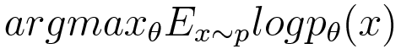
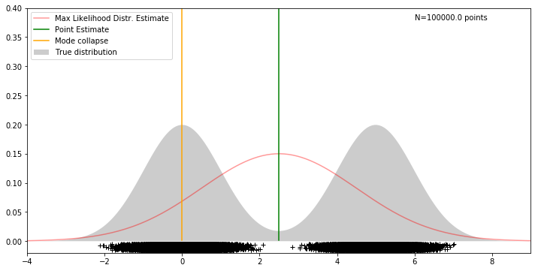
Understanding Maximum Likelihood and VAEs
Maximum Likelihood is essentially smoothly filling in the distribution, but that is not what we want
Neither is mode collapse however
Also, notice that with MLE we have to specify distribution family
Notes:
That is becuase a lot of “smooth” transitions do not make sense—if I have a blonde hair, all (most) of my hair will be blonde. So one variable should impact a lot of pixels!
Great further explanation: https://www.youtube.com/watch?v=5R28W5FnSxM&list=WL&index=47&t=141s

Slide 7
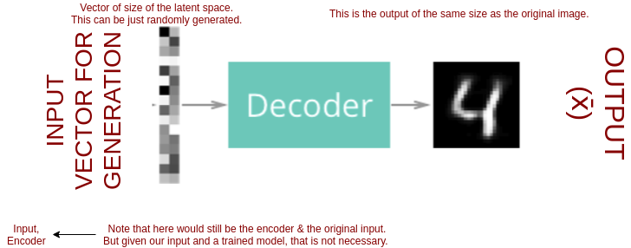
How does ML generation work?
Example of an autoencoder
Sample from a random seed
Run that through this learnable function generate()
Get an output
Notes:
I think this is a bit of a weird transition -> DOES NOT FOLLOW FROM THE PREVIOUS SLIDE
So most people have not done much gen. model so this is for baselining. There are many ways but in ML we try to have a gen() function and improve it.
We’re always trying to max some real data distr., but different objective functions: so we’re really introducing two agents competing.

Slide 8
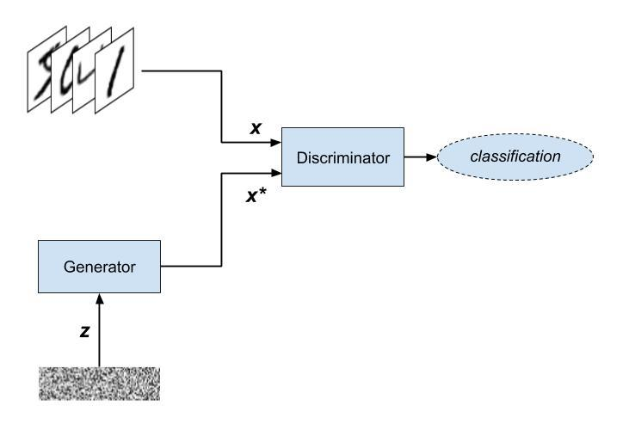
What are Generative Adversarial Networks?
Notes:
Network ->
There is 2
Adversarial -> they compete against each other
Unsupervised
Trial-and-error
Imagine you have a good generator
Now you have to make the generator improve (backprop)
So does the discriminator (needs to keep pace)
Do this over and over
Like store owner & counterfeiter
Latent Space forget about for now but is important

Slide 9
What are the components?
 | Generator | Discriminator
Input | A vector of random numbers | The Discriminator receives input from two sources: Real examples coming from the training dataset Fake examples coming from the Generator
Output | Fake examples that strive to be as convincing as possible | Likelihood that the input example is real
Goal | Generate fake data that are indistinguishable from members of the training dataset | Distinguish between fake examples coming from the Generator and real examples coming from the training dataset
Notes:
We’ll go over this in a couple of different ways so don’t worry

Slide 10
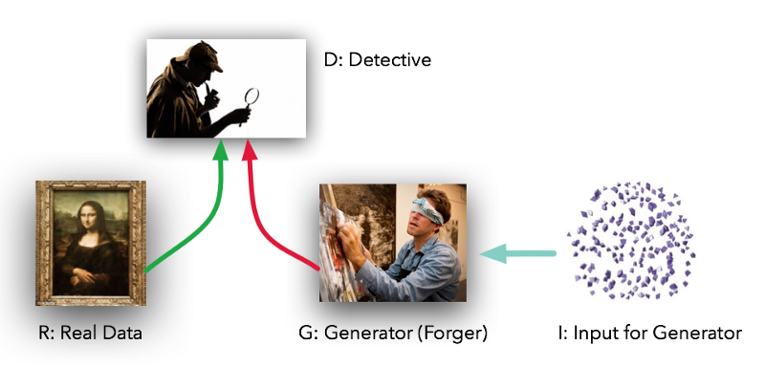
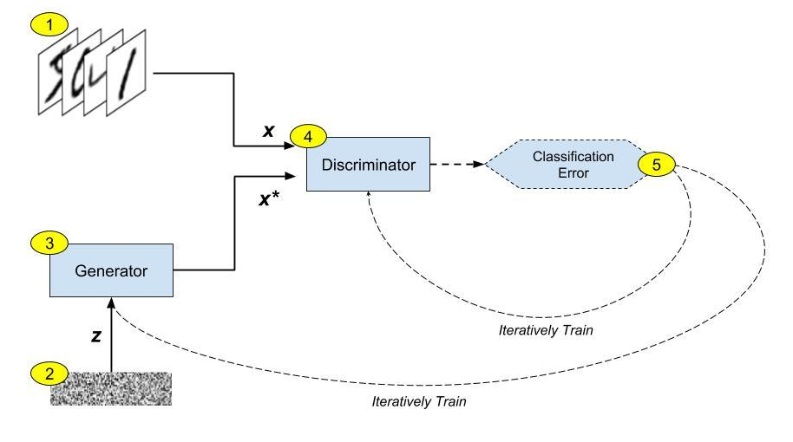
An analogy: art critic and a forger
Exhibition competition: trying to create the best art exhibit possible.

Slide 11
GANs learn iteratively

Slide 12
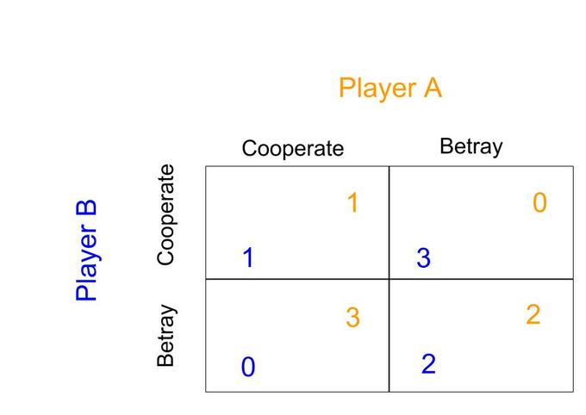
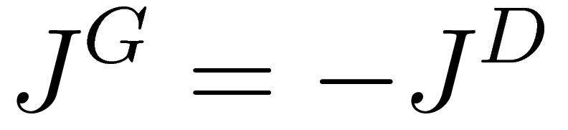
Training objective: Min-Max
(the game theoretical one)
Notes:
J^D = -.5E_{x \sim p_d } log[D(x)] - .5 E_{z \sim p_g } log[1-D(G(z))]

Slide 13
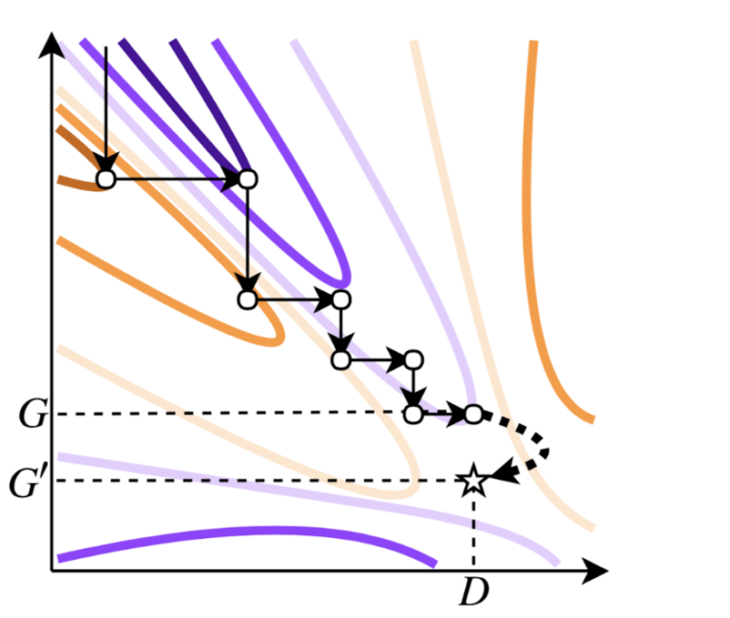
Training objective: Min-Max training
Figure 1: The contour diagram shows how GAN training is an adversarial process, alternating between minimizing and maximizing the joint value function. The generator G optimizes for orange, and the discriminator D optimizes for purple. If GAN training ends at (D, G), where G is imperfect but D is perfect for that G, we can obtain a new generator G’ that perfectly models the data distribution by sampling from the pD distribution.
Figure from Uber Research (https://eng.uber.com/mh-gan/)
Notes:
J^D = -.5E_{x \sim p_d } log[D(x)] - .5 E_{z \sim p_g } log[1-D(G(z))]

Slide 14
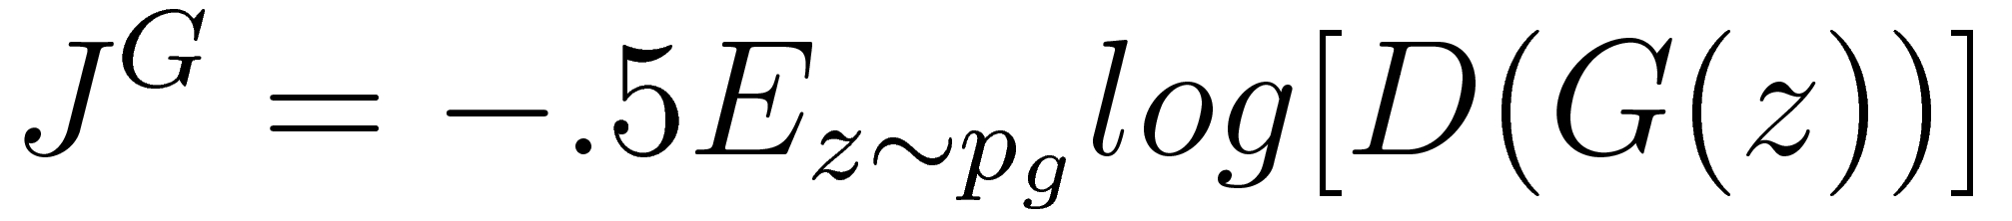
Training objective: Non-Saturating
(the one that people actually use)
Notes:
J^D = -.5E_{x \sim p_d } log[D(x)] - .5 E_{z \sim p_g } log[1-D(G(z))]
Maybe remove the negation to make it cleat that for D output 1 iff real, 0 iff synthetic

Slide 15
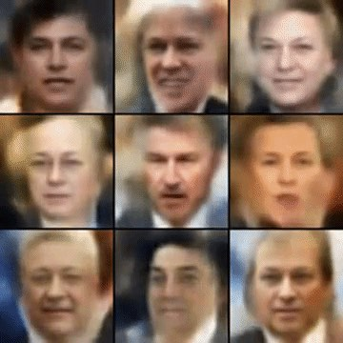
So why is this an interesting problem?
Generative modelling has been largely unsolved. We are moving closer to using unsupervised learning as a workable paradigm.
“What I cannot create, I do not understand”
Variational autoencoders have typically been the SOTA.
There’s lots of applications: semi-supervised learning, representation learning, data generation / augmentation etc.
Notes:
“What I cannot create, I do not understand” -> Richard Feynman
Unsupervised learning is often consider the holy grail. Because the presence of labels is considered a huge constraint (eg, argument that data >> algos)
Lots of problems struggle with high dim, but GANs have a neat soln for it
Check out the SOTA (VAE)
Generative learning has many useful applications for very broad areas, not just individual cases

Slide 16
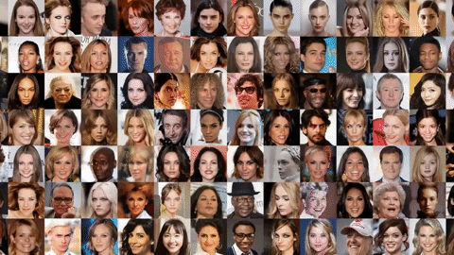
Why are GANs
so incredible?
Notes:
Yan LeCunn
nVIdia Progressive 1024x1024

Slide 17
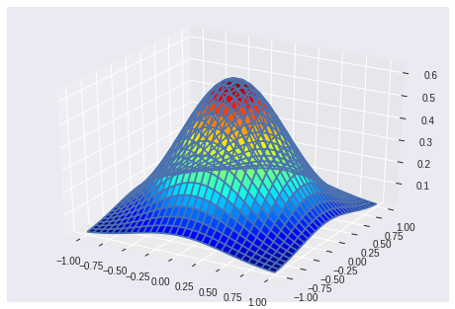
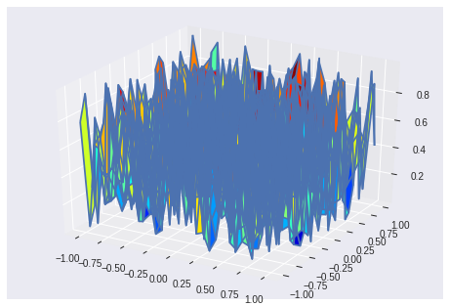
Manifold Assumption
Lots of great work coming from Sanjeev Arora (Princeton)
We are essentially trying to map the input (seeding) noise onto the manifold of the output dataset.
In practice, we have to only use approximate versions
There are capacity, training time and convergence limitations
Notes:
“What I cannot create, I do not understand” -> Richard Feynman
Unsupervised learning is often consider the holy grail. Because the presence of labels is considered a huge constraint (eg, argument that data >> algos)
Lots of problems struggle with high dim, but GANs have a neat soln for it
Check out the SOTA (VAE)
Generative learning has many useful applications for very broad areas, not just individual cases

Slide 18
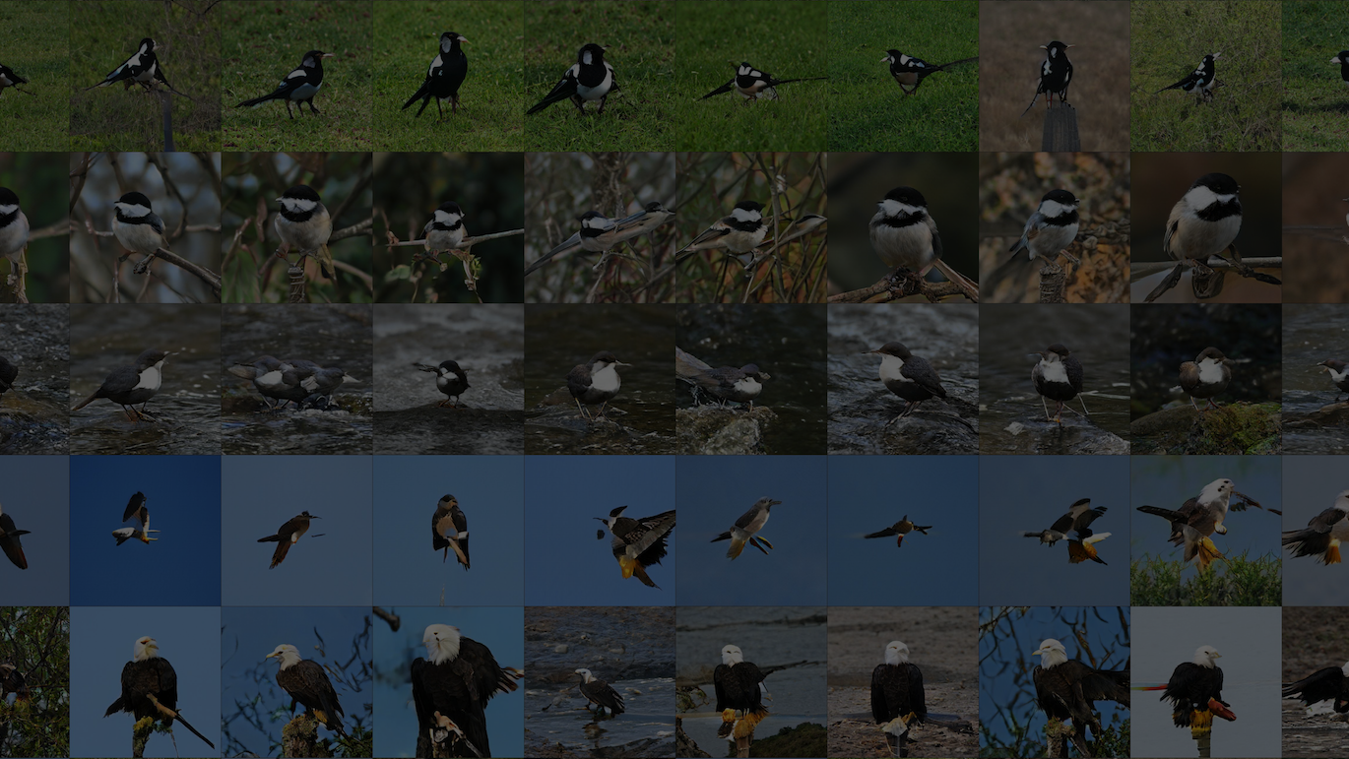
Popular Architectures

Slide 19
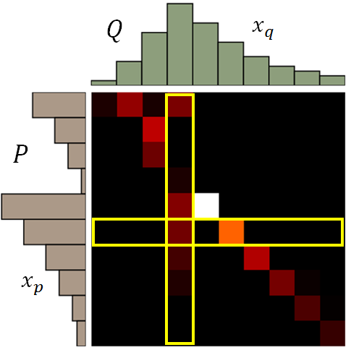
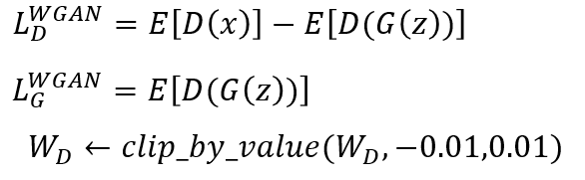
Wasserstein GAN
Wasserstein GAN is a virtually instant academic and practitioner favourite.
Measures loss as the amount of probability mass that needs to get transported before the generated distribution looks like the real one.
Notes:
So most people have not done much gen. model so this is for baselining. There are many ways but in ML we try to have a gen() function and improve it.
We’re always trying to max some real data distr., but different objective functions: so we’re really introducing two agents competing.
Complicated to the point of being intractable even just for evaluation

Slide 20
def upscale_layer(layer, upscale_factor): ''' Upscales layer (tensor) by the factor (int) ''' height = layer.get_shape()[1] width = layer.get_shape()[2] upscaled_layer = tf.image.resize_nearest_neighbor(layer, (scale * height, scale * width)) return upscaled_layer
def smoothly_merge_last_layer(list_of_layers, alpha): ''' Smoothly merges in a layer based on a threshold value alpha. This function assumes: that all layers are already in RGB. This is the function for the generator. :list_of_layers : items should be tensors ordered by size :alpha : float \in (0,1) ''' with tf.variable_scope('generator'): last_fully_trained_layer = list_of_layers[-2] # now we have the originally trained layer last_layer_upscaled = upscale_layer(last_fully_trained_layer, 2) # this is the newly added layer not yet fully trained larger_native_layer = list_of_layers[-1]
# This code block should take advantage of broadcasting new_layer = (1-alpha) * upscaled_layer + larger_native_layer * alpha return new_layer
Notes:
Complicated to the point of being intractable even just for evaluation
https://colab.research.google.com/github/tensorflow/hub/blob/r0.1/examples/colab/tf_hub_generative_image_module.ipynb

Slide 21
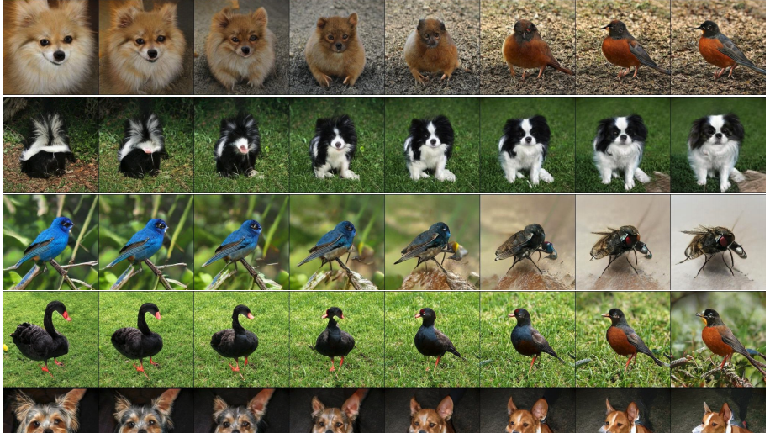
Variation

Slide 22
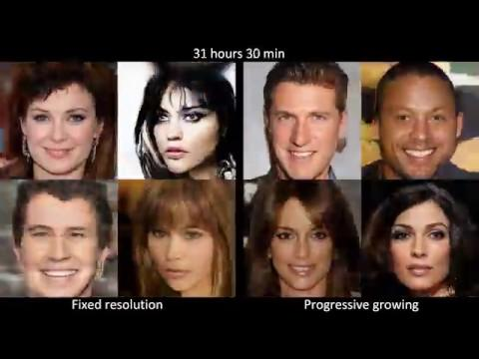

Slide 23
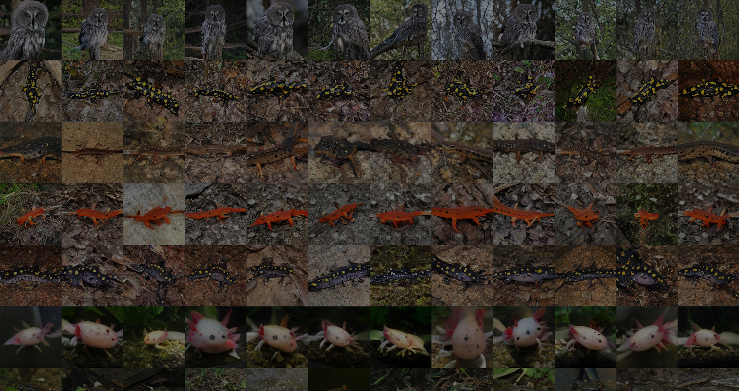
CycleGAN

Slide 24
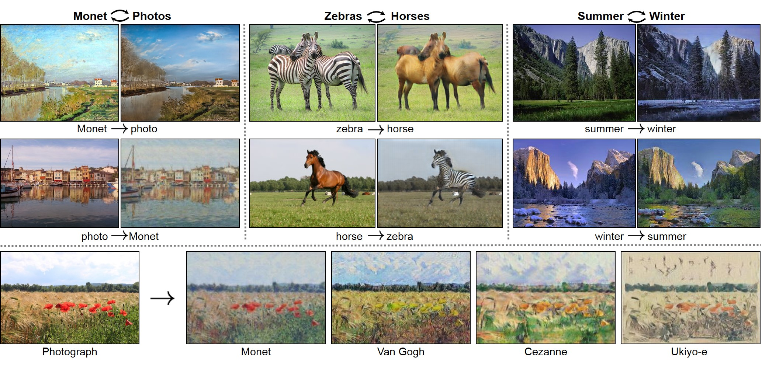
CycleGAN: a new approach to domain transfer
Unpaired domains: cyclical loss
More complex architecture, but the results are worth it
Extensions already exist, but e.g. Progressive CycleGAN has not been tried yet
Notes:
In CycleGAN -> adversarial loss is for changing style
-> cycle-consistetncy loss is for perserving content
Also good notes about PatchGAN: https://www.youtube.com/watch?v=EXLRZr0k8ok at about 35 mins in

Slide 25
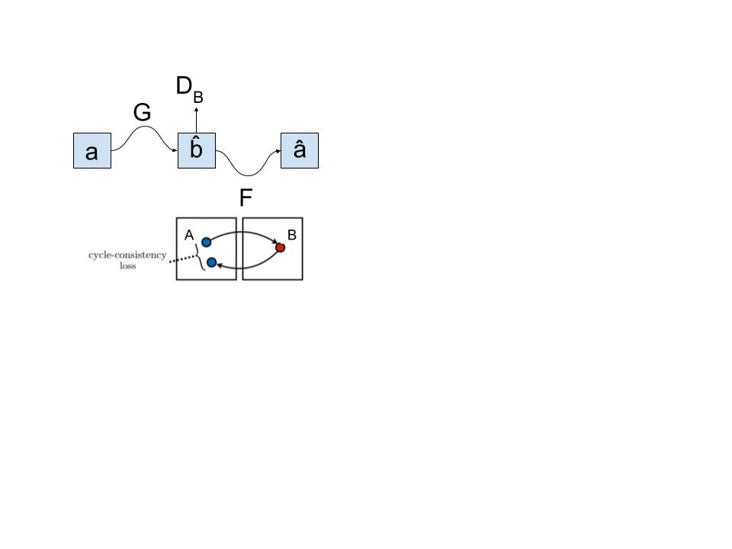
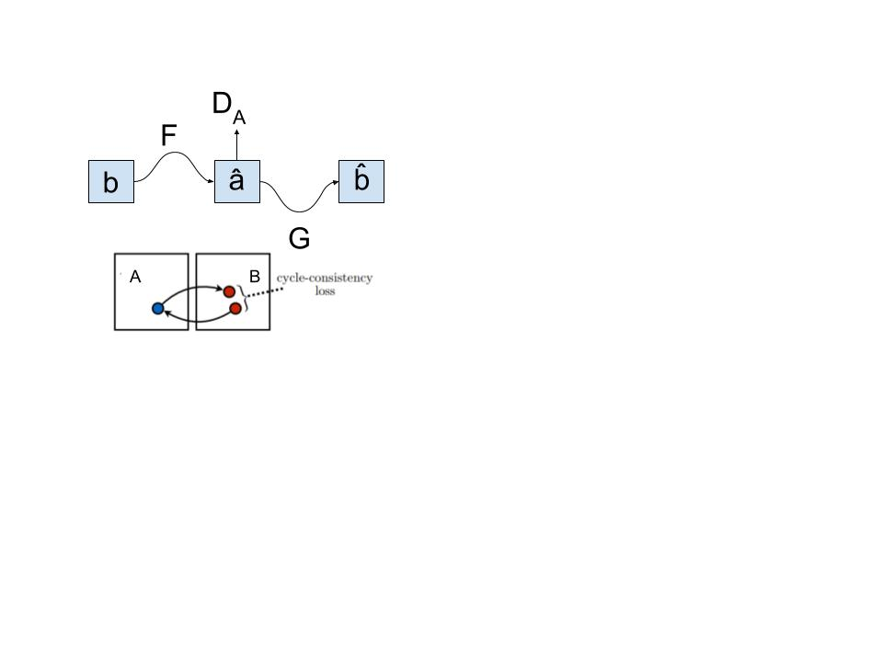
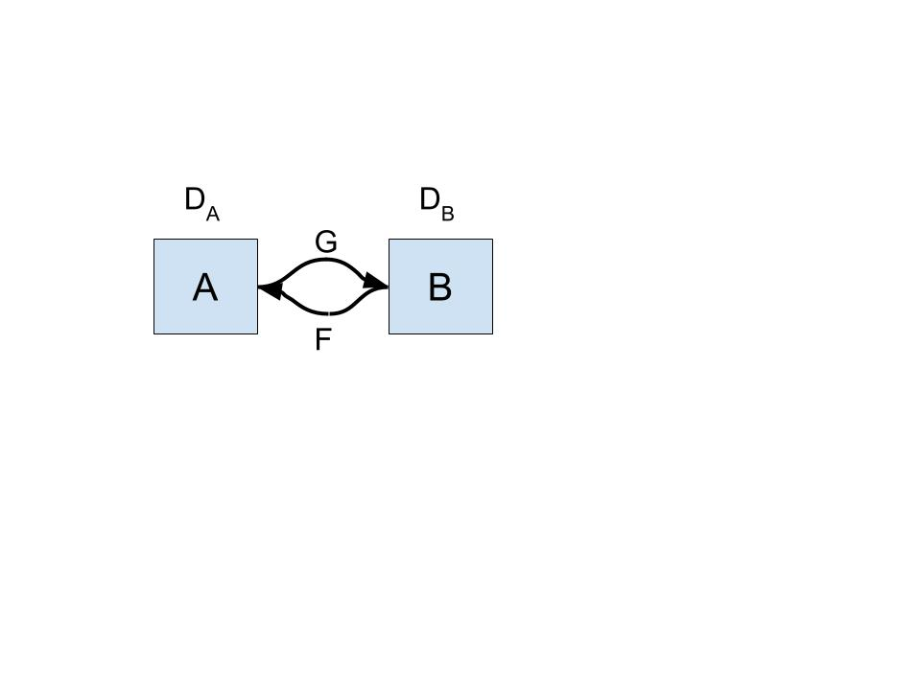
CycleGAN architecture
Idea of cyclical loss. Also remember, that because the loss works both ways, we can now reproduce not just images from summer to winter, but also from winter to summer. In other words if G is our generator from A to B and F is our generator from B to A, then a = F(G(a)) a.
Notes:
In CycleGAN -> adversarial loss is for changing style
-> cycle-consistetncy loss is for perserving content
Also good notes about PatchGAN: https://www.youtube.com/watch?v=EXLRZr0k8ok at about 35 mins in

Slide 26
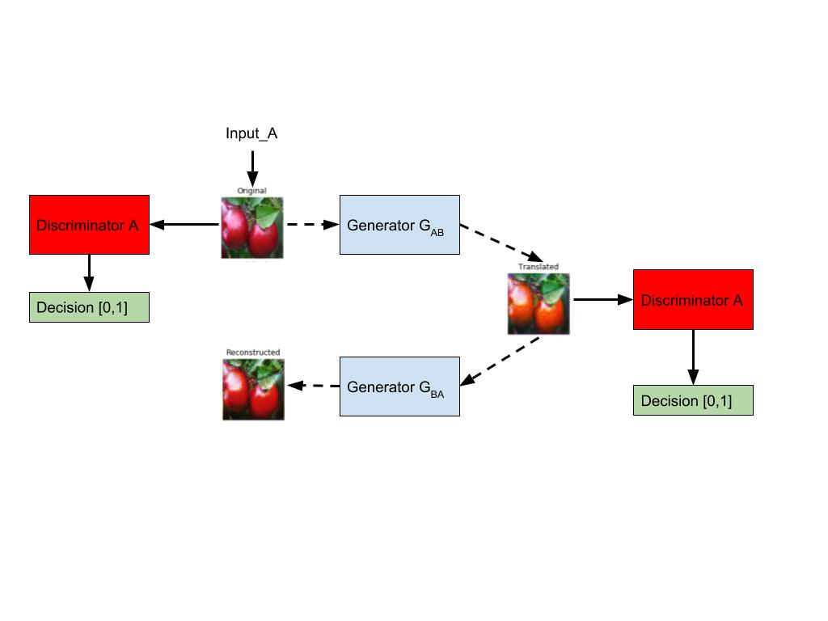
CycleGAN architecture
Notes:
In CycleGAN -> adversarial loss is for changing style
-> cycle-consistetncy loss is for perserving content
Also good notes about PatchGAN: https://www.youtube.com/watch?v=EXLRZr0k8ok at about 35 mins in

Slide 27
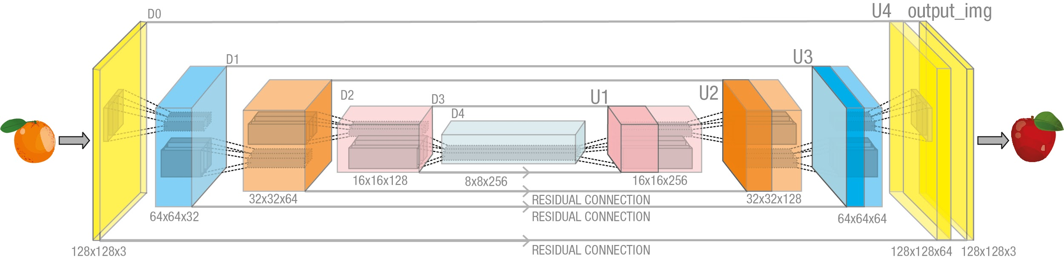
CycleGAN: Discriminator Architecture
Notes:
PatchGAN architecture

Slide 28
Where did GANs come from?

Slide 29

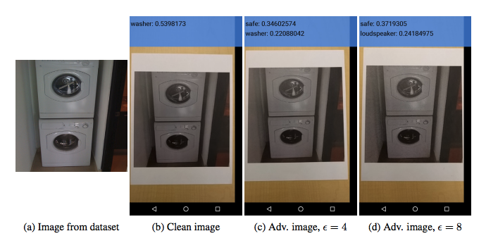
Adversarial Attacks: Inspiration for GANs
Adversarial attacks were a predecessor to GANs (2004-ish)
Adding specially selected noise to the image times some tiny fraction so that for humans it looks the same
Adversarial Attacks came from the observation that many deep learning models are over-confident even relatively out-of-distribution
Notes:
Bottom img from Kurakin et al 2016 — printed adv. images

Slide 30
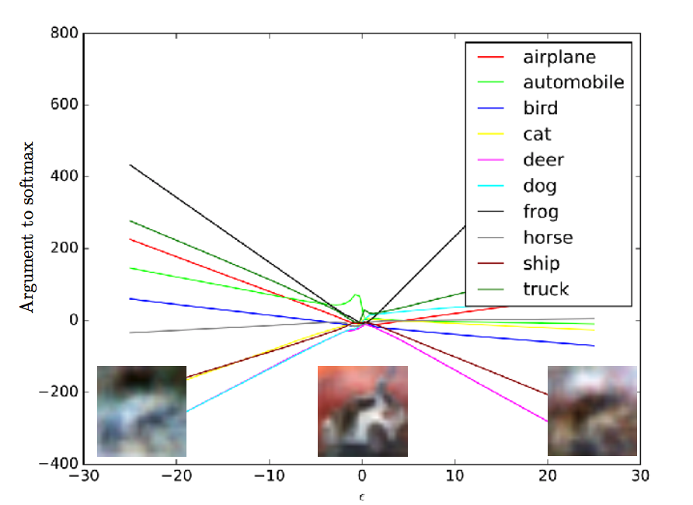
Why do adversarial attacks work at all?
Comes from excessive linearity of the high-dimensional sample space
Demonstrates the fragility of many existing classifiers, but in practice these tend to be less problematic
“Looks flashy” and is an “interesting academic problem”
Many formulations: single pixel attacks, max-𝝐 attacks, region attacks
(image from Ian Goodfellow, 2017)
Notes:
Our models do not do extrapolation well

Slide 31
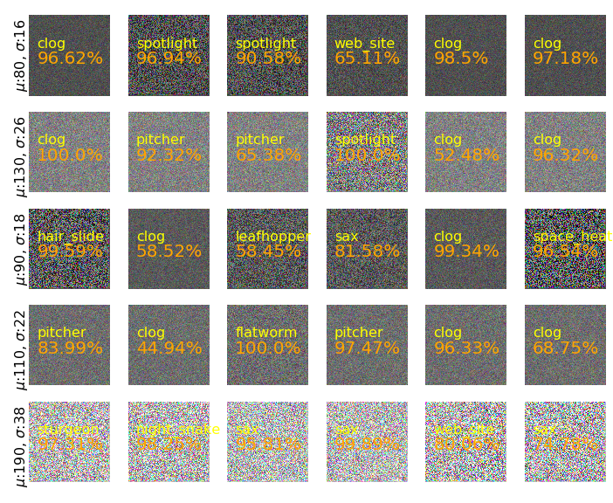
How bad is it? Does supervised learning suffer from this?
Modern ML is wrong “almost everywhere”—except for the thin manifold around the training data
Gaussian noise (mean and std on the side) through InceptionV3 gives:
Ran on a state-of-the-art classifier from 2014
Yellow class designation, orange: confidence
@langrjakub
Notes:
25% success on airplanes—yet one of the rarest clasases

Slide 32
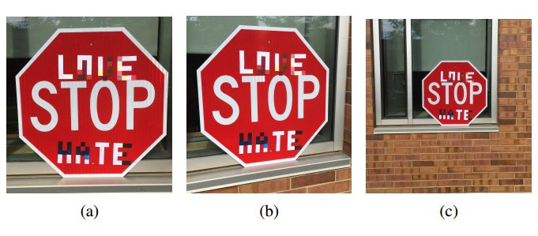
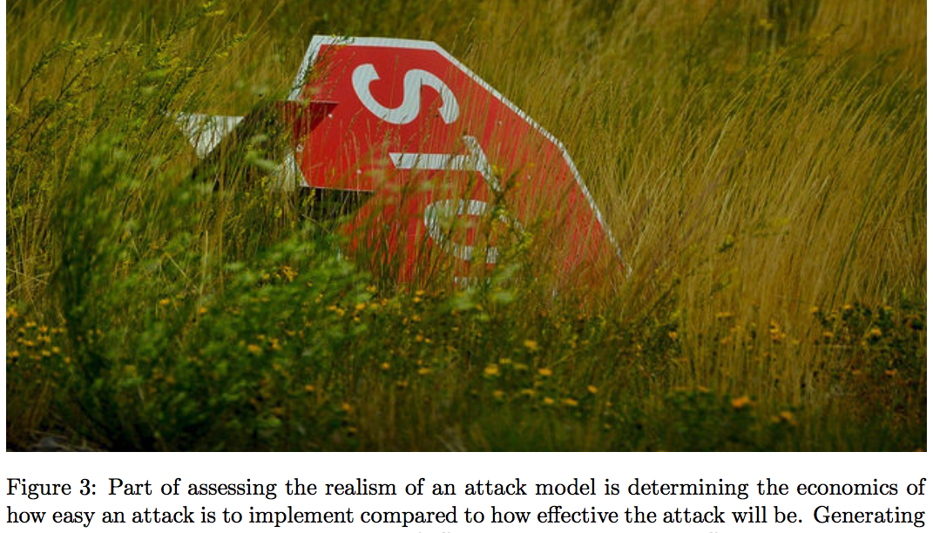
So is ML doomed? — No, let’s think like attackers.
Generally, this “imperceptible” attacks are quite unrealistic setting
There are simpler attacks if we have that level of access—both time-wise and knowledge wise
Even “well performing” models generally are not perfect in-sample
If we have access to even the model weights, we probably have bigger problems!
But solving this is also hard, essentially requires test error = 0!
Notes:
Also hopefully this gives us a better way to train our models by creating random perturbations to the test set—increasing sample-size for free
~~ data augmentation

Slide 33
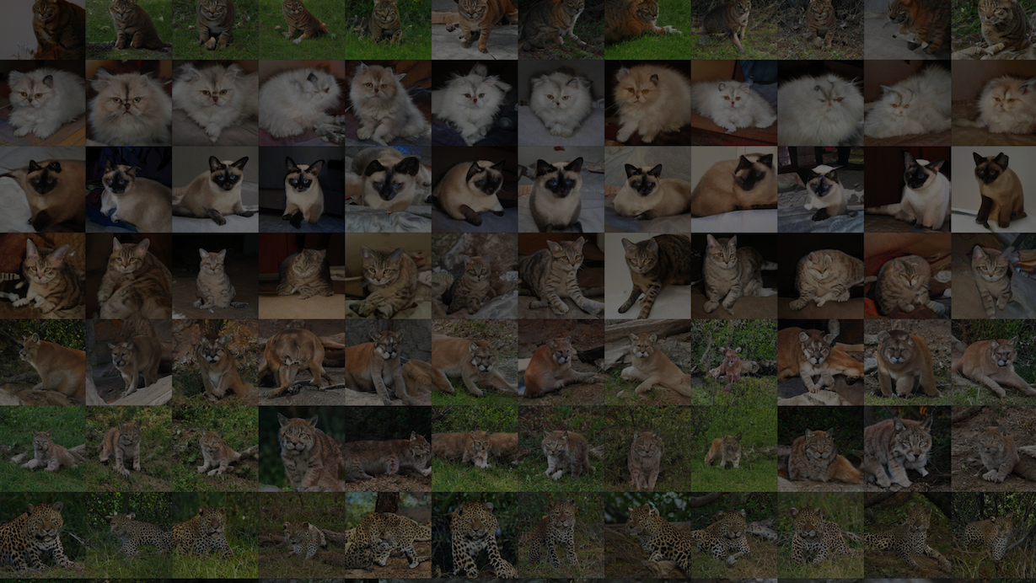
Practical Applications

Slide 34
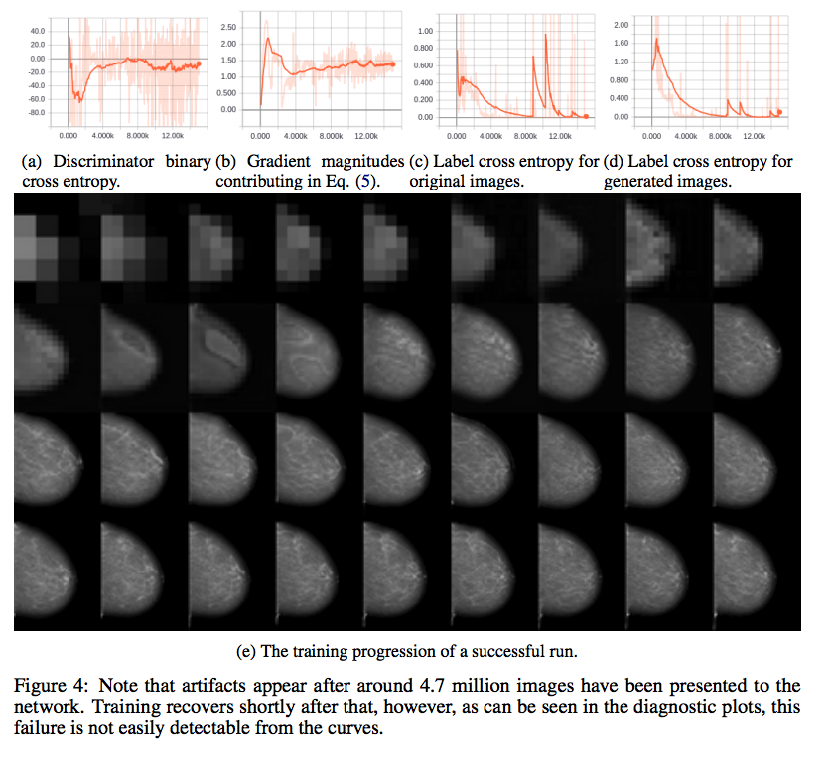
PGGAN: Practical applications
Notes:
Figure 6.8: Progressive growing of FFDM. This is a great figure because it not only shows the progressively increasing resolution on these mammograms (e), but also some training statistics (a)-(d) to show you that training these GANs is messy for everyone, not just you.

Slide 35
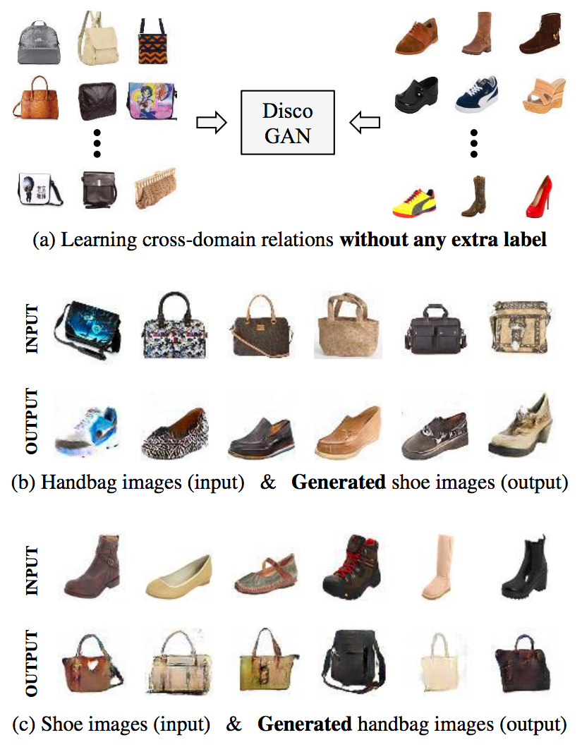
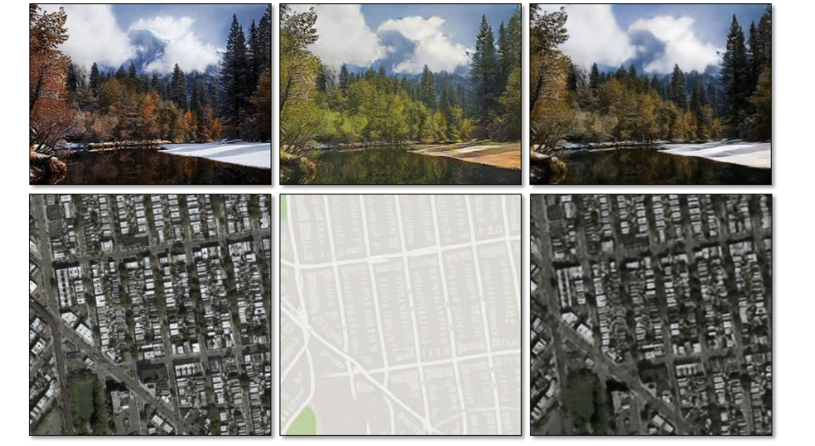
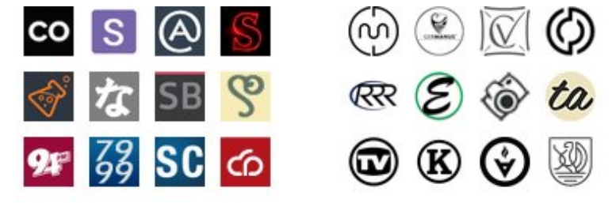
Creative Applications: Design at scale
Input (X) Generated F(X) Reconstructed G(F(X))
Notes:
Let’s walk through in order:
CycleGAN, (b) Logo synthesis, (c) DIscoGAN
Power of conditioning & domain transfer
Basically generate posters ?
Basically talk the creative application for studios

Slide 36
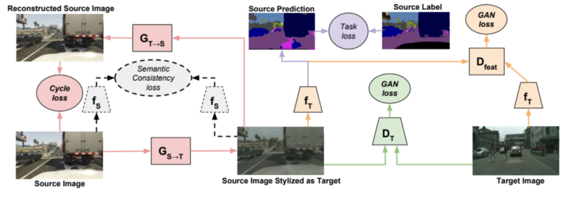
CycleGAN: CyCada Application
Notes:
Similarily: Sim2real
https://www.youtube.com/watch?v=DXsLDyiONV4
https://data.vision.ee.ethz.ch/aeirikur/extremecompression/#publication

Slide 37
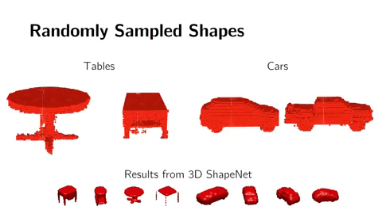
More exotic 3D Applications
Apple, Google have used in production for UX studies, better usability or robotics etc.
Host of applications that would soon lend themselves to digital asset creation, design, architecture or even engineering.
So we can learn pretty complex distributions conditionally!
Other interesting purposes include data augmentation beyond simple transforms or style transfer.
Notes:
This is the next logical step & really shows the power of this method, but obviously needs a lot of work
But it can already provide a decent starting point.
Don’t forget that we can chain conditioning. This all can work as long as we have enough unsupervised data. So the data acquisition strategy changes a bit.

Slide 38
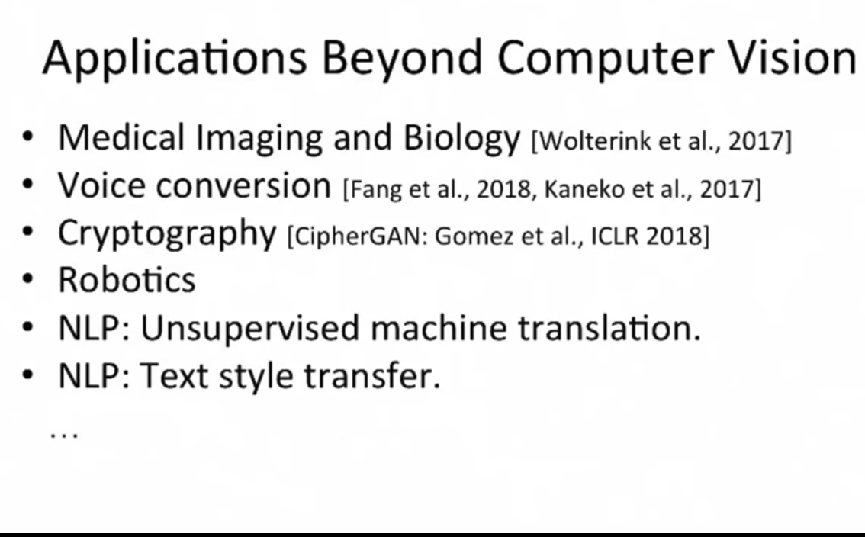
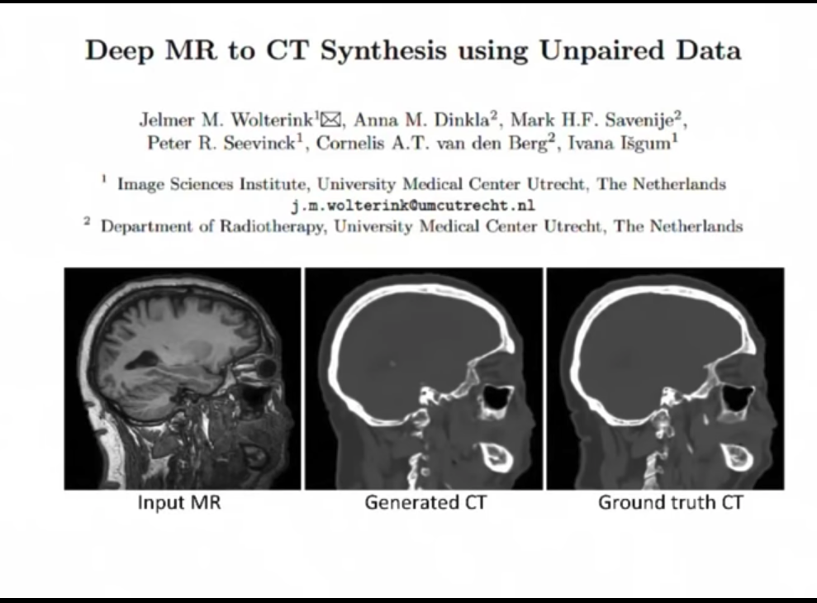
CycleGAN: practical applications
Notes:
https://www.theregister.co.uk/2018/05/22/ai_generated_teeth_dentists/
https://machinelearning.apple.com/2017/07/07/GAN.html

Slide 39
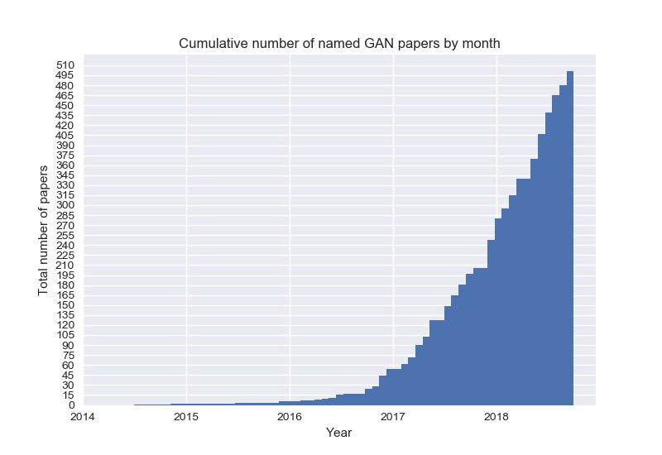
In context
This paper is amazing because it also introduced other innovations: (i) Equalized learning rate, (ii) Pixel Normalization, (iii) Sliced Wasserstein Distance
Currently only matched by SN-GAN in resolution, though “BIGGAN” (Nov) has more variance and StyleGAN has better controls
There are extensions already proposed
Software engineering-wise this was the first GAN to be on TFHub!
Notes:
So this is all still an active area of research

Slide 40
References & links
Zhu, J.-Y., Park, T., Isola, P., & Efros, A. A. (2017). Cycle-GAN: Unpaired Image-to-Image Translation using Cycle-Consistent Adversarial Networks. https://doi.org/10.1109/ICCV.2017.244
Zhu, J.-Y., Krähenbühl, P., Shechtman, E., Efros, A. A., & Research, A. (n.d.). Generative Visual Manipulation on the Natural Image Manifold. Retrieved from https://arxiv.org/pdf/1609.03552v2.pdf
Brock, A., Deepmind, J. D., & Deepmind, K. S. (n.d.). LARGE SCALE GAN TRAINING FOR HIGH FIDELITY NATURAL IMAGE SYNTHESIS. Retrieved from https://arxiv.org/pdf/1809.11096.pdf
Images
http://www.cvc.uab.es/people/joans/slides_tensorflow/tensorflow_html/gan.html
https://jaan.io/images/variational-autoencoder-faces.jpg
https://github.com/hindupuravinash/the-gan-zoo/blob/master/cumulative_gans.jpg
All animations from the Karras et al. ICLR 2018 presentation are from the official GitHub repository and are under the CC-NC-4.0 license as stated here: https://github.com/tkarras/progressive_growing_of_gans
Papers cited
Kingma, D. P., & Welling, M. (2013). Auto-Encoding Variational Bayes. Retrieved from http://arxiv.org/abs/1312.6114
Karras, T., Aila, T., Laine, S., & Lehtinen, J. (2017). Progressive Growing of GANs for Improved Quality, Stability, and Variation. Retrieved from http://arxiv.org/abs/1710.10196
Wu, J., Zhang, C., Xue, T., Freeman, W. T., & Tenenbaum, J. B. (2016). Learning a Probabilistic Latent Space of Object Shapes via 3D Generative-Adversarial Modeling. Retrieved from http://arxiv.org/abs/1610.07584
Shrivastava, A., Pfister, T., Tuzel, O., Susskind, J., Wang, W., & Webb, R. (2016). Learning from Simulated and Unsupervised Images through Adversarial Training. Retrieved from http://arxiv.org/abs/1612.07828
Bousmalis, K., Silberman, N., Dohan, D., Erhan, D., & Krishnan, D. (n.d.). Unsupervised Pixel–Level Domain Adaptation with Generative Adversarial Networks. Retrieved from http://openaccess.thecvf.com/content_cvpr_2017/papers/Bousmalis_Unsupervised_Pixel-Level_Domain_CVPR_2017_paper.pdf
Goodfellow, I. (2016). Generative Adversarial Networks. In NIPS.
Notes:
So this is all still an active area of research

Slide 41
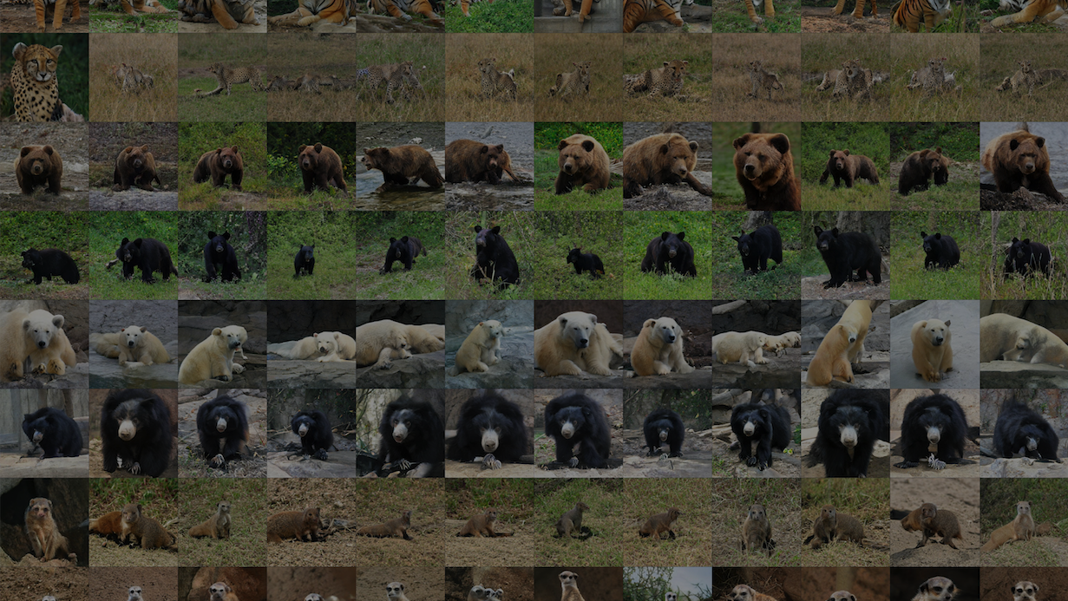
Colabs
Notes:
https://github.com/GANs-in-Action/gans-in-action

Slide 42
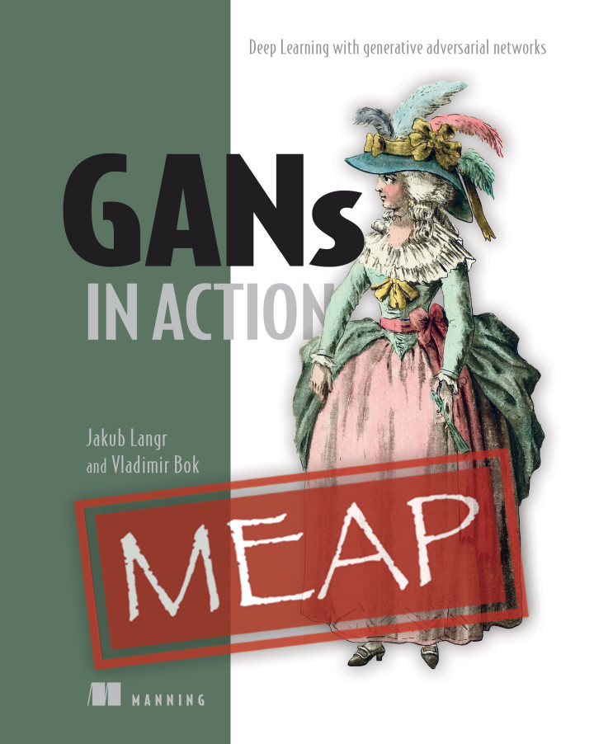
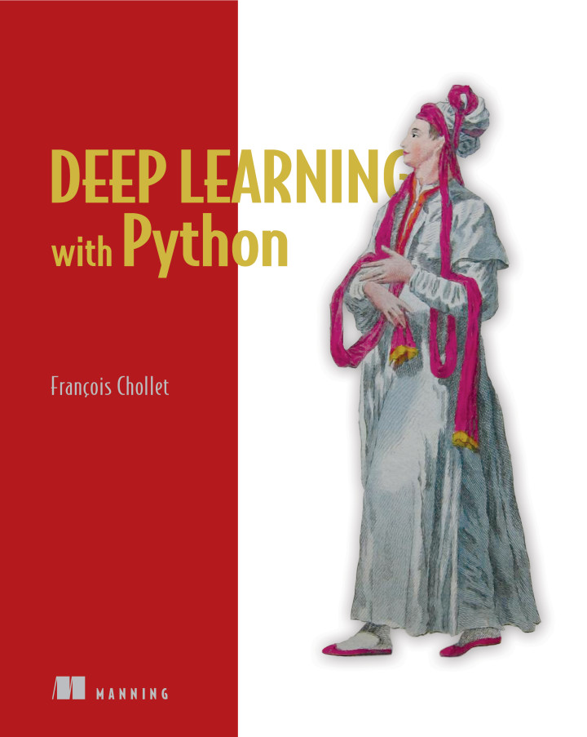
Plugs! (... with varying degrees of shame.)
Get the GAN book!
bit.ly/gan-book
bit.ly/keras-book (by F. Chollet)

Slide 43
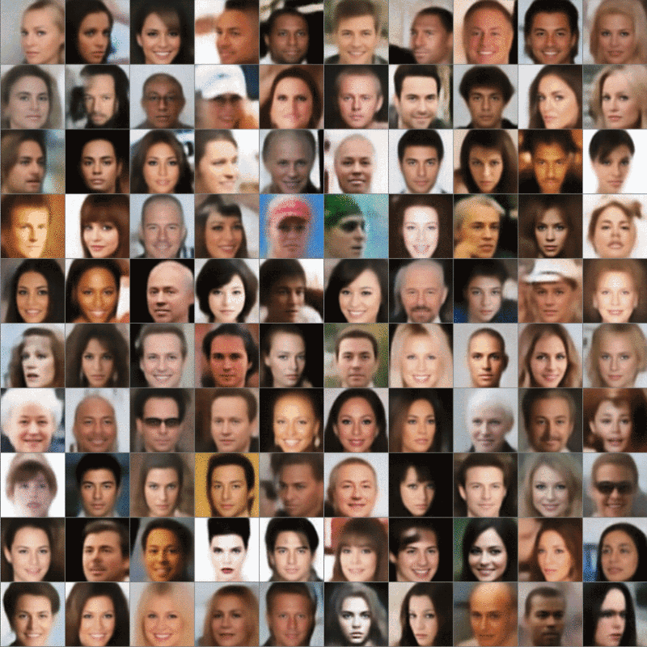
Thank you!
Any questions?
jakublangr.com
@langrjakub

Slide 44
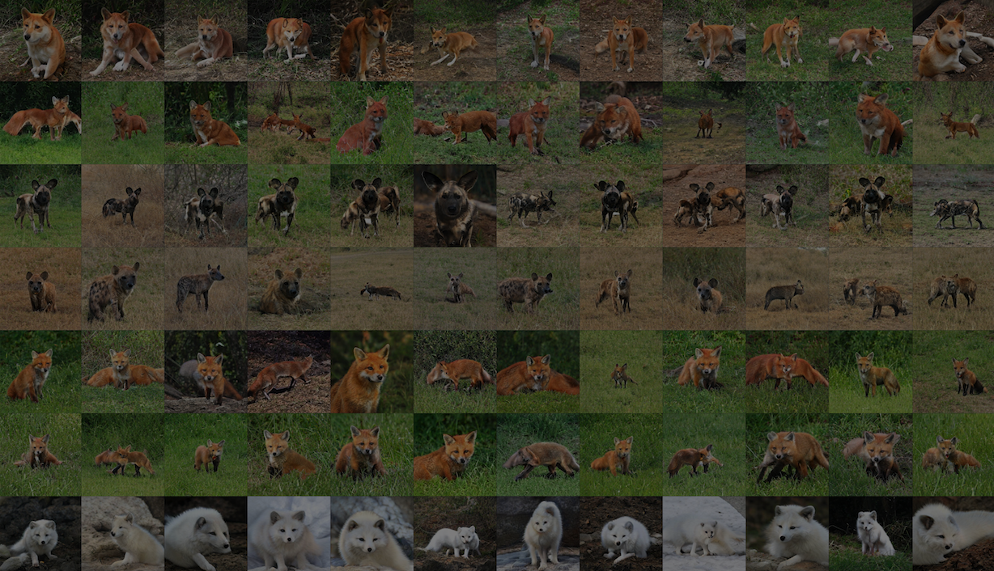
Videos
Videos
Notes:
https://www.youtube.com/watch?v=kSLJriaOumA&feature=youtu.be StyleGAN
Invertible Conditional GANs
https://www.youtube.com/watch?v=3AIpPlzM_qs&feature=youtu.be
One hour of imaginary celebrities
https://www.youtube.com/watch?v=36lE9tV9vm0
Deep Dream
https://www.youtube.com/watch?v=EjiyYtQIEpA
Everybody dance now
https://www.youtube.com/watch?v=PCBTZh41Ris
Vid2Vid
https://www.youtube.com/watch?v=GrP_aOSXt5U&feature=youtu.be

